Slide 1
Transforming Monolithic Applications to Microservices with Mono2Micro
Rahul Krishna, Anup K. Kalia, Saurabh Sinha, Rachel Tzoref-Brill, John Rofrano, Jin Xiao,
IBM Research, Yorktown Heights, NY
ASE Tutorial, 2021
14-15 November 2021

Slide 2
Problem
Decompose legacy monolithic applications. Primarily there are two approaches.
**Static Approaches (Bunch, MEM, CoGCN)**
Face challenges in dealing with dynamic language features, such as reflection, dynamic class loading, context, and dependency injections
**Dynamic Approaches (FoSCI)**
Need use cases, provide varying coverages
**Bigger Problems**
Lack of alignment between classes and their dependencies with the business functionalities of an application
Lack of explanability

Slide 3
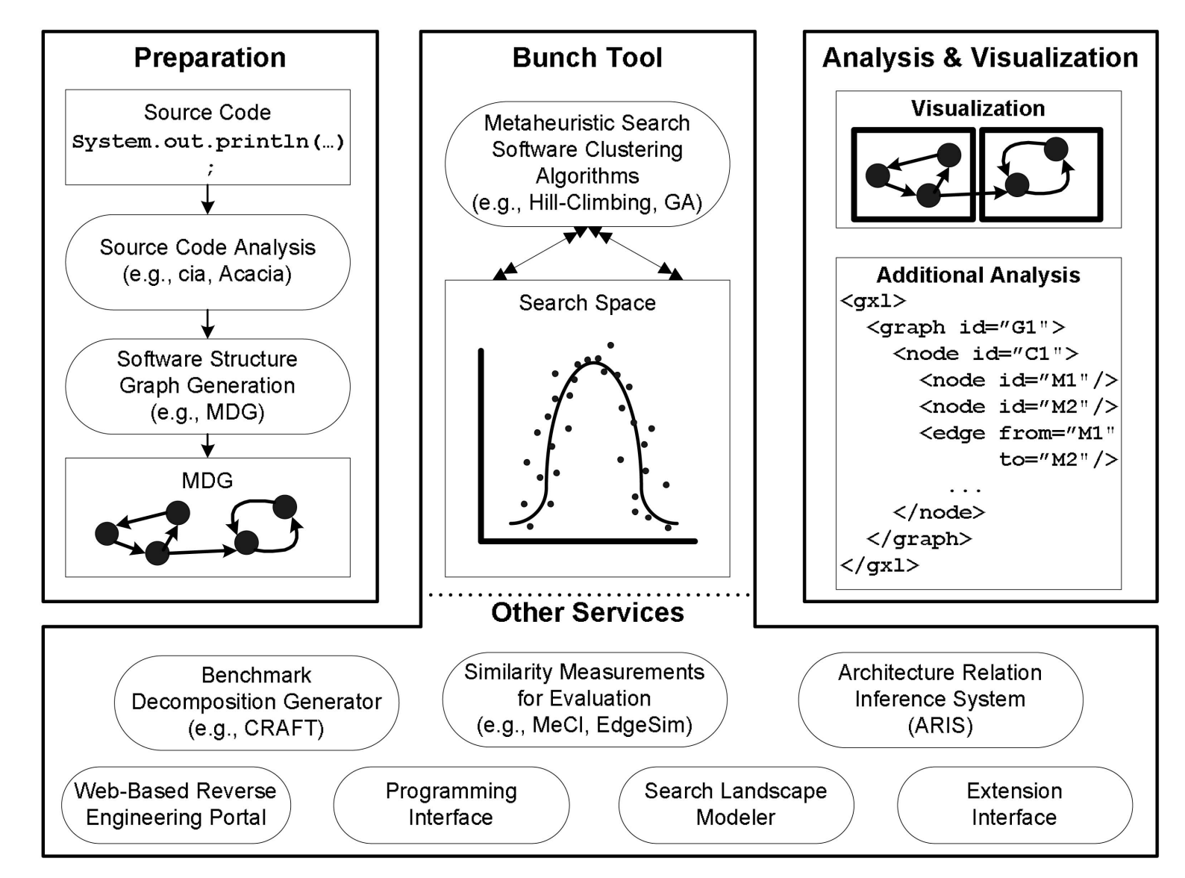
Static Approach: Bunch
Bunch considers the hill-climbing algorithm to generate partitions from an external module dependency graph (MDG)
On the automatic modularization of software systems using the Bunch tool [IEEE TSE, 2006]

Slide 4
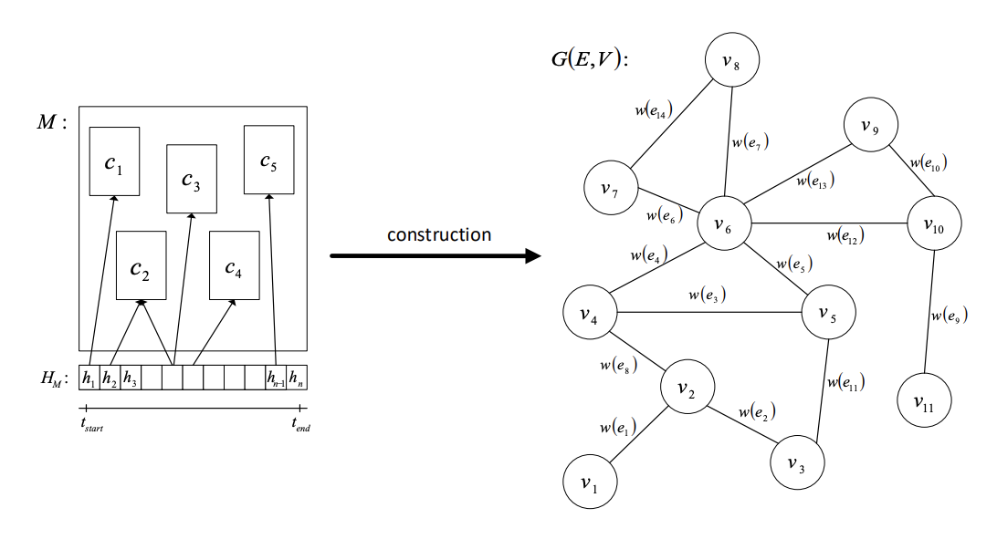
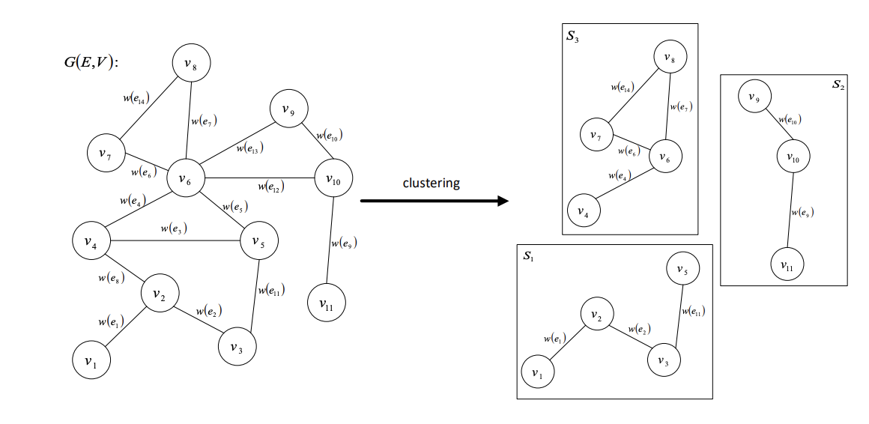
Static Approach: MEM
MEM considers the minimum spanning tree (MST) approach to generate partitions.
Change History (Classes, Change History, Developers)
Extraction of Microservices from Monolithic Software Architectures [ICWS, 2017]

Slide 5
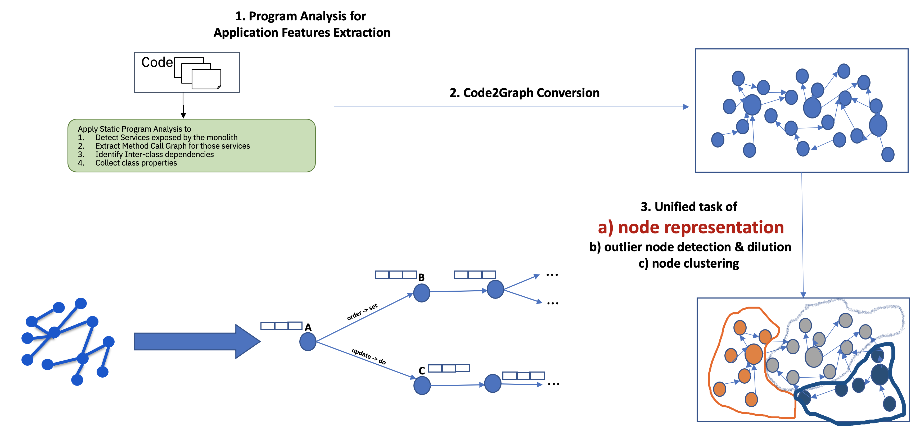
Static Approach: CoGCN
CoGCN partitions a monolith by minimizing the effect of outlier classes that might be present in the embeddings of other classes
Graph Neural Network to Dilute Outliers for Refactoring Monolith Application [AAAI, 2021]

Slide 6
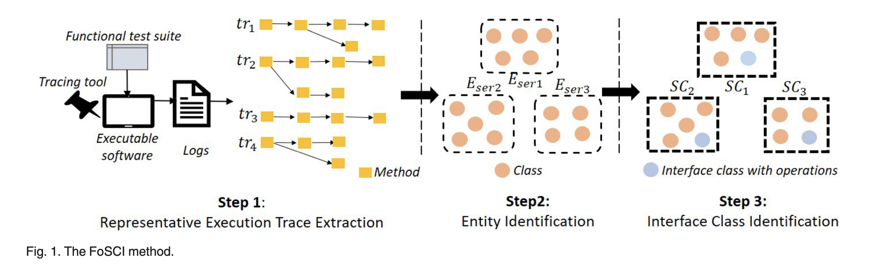
Dynamic Approach: FoSCI
FoSCI creates functional atoms using a hierarchical clustering approach and merges the atoms using a genetic algorithm to generate final partitions
Service Candidate Identification from Monolithic Systems based on Execution Traces [IEEE TSE, 2019]

Slide 7
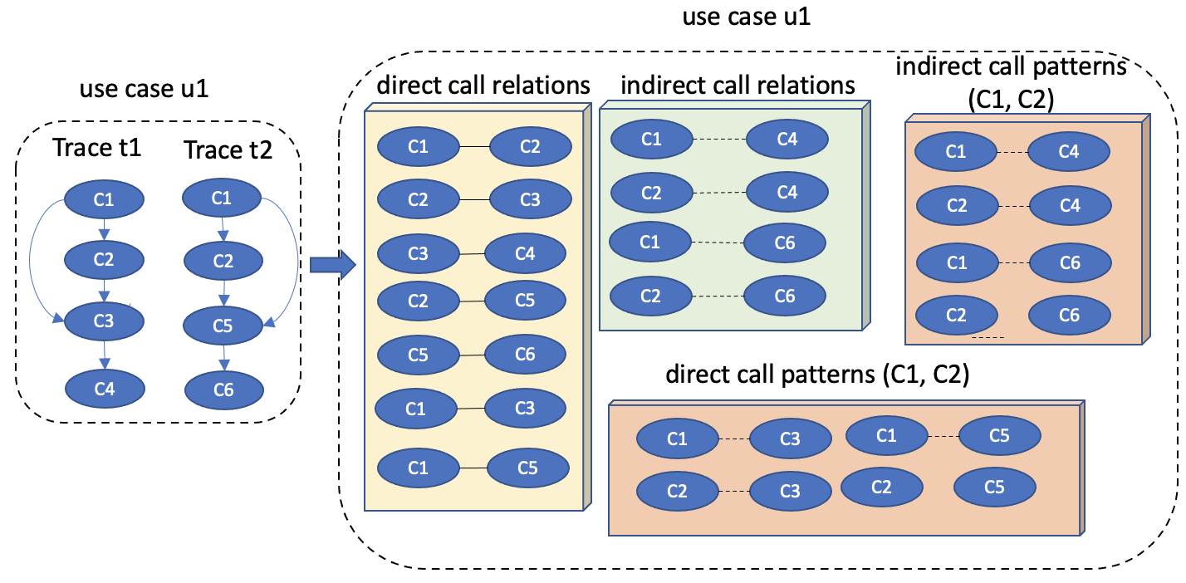
Proposal
We propose a dynamic approach based on the hierarchical spatio-temporal decomposition of runtime traces.
Business Use Cases (Space): Mono2Micro considers call relationships on the contexts of business use cases under which they occur
Runtime Call Traces (Temporal): Mono2Micro considers direct and indirect temporal relations and patterns among classes from runtime call traces

Slide 8
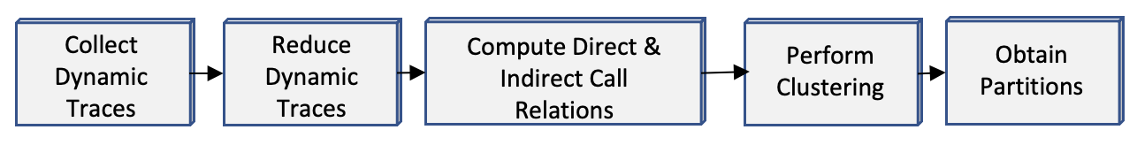
Technical Approach
Step 1
Step 2
Step 3
Step 4
Step 5

Slide 9
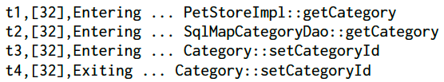
Step 1: Collect Dynamic Traces
JPetStore:
44 use cases (e.g., update item, click item)
88% coverage (37/42 classes).
Timestamp
Entry/Exist label
Class name :: function
Thread ID

Slide 10
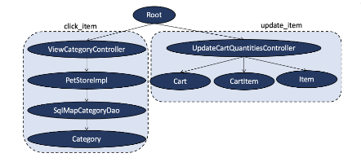
Step 2: Reduce Dynamic Traces
Trace reduction happens in two steps
Consider unique traces
Remove redundant sequence of classes that might have been invoked due to the presence of a loop
We use calling-context Trees (CCT) to remove redundant traces

Slide 11
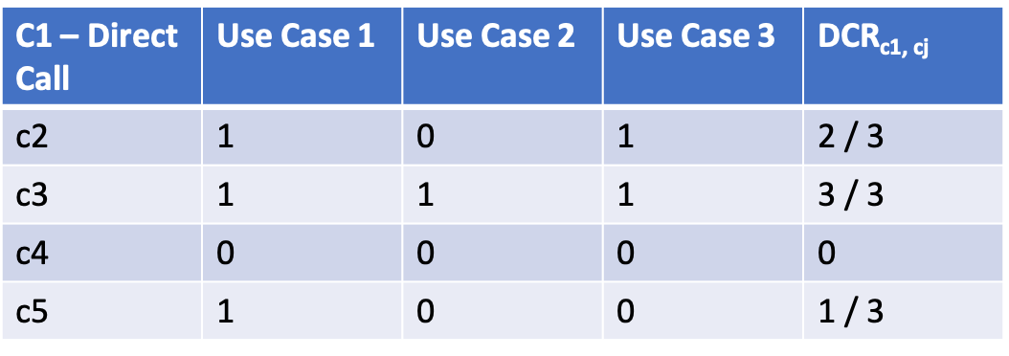
Step 3a: Compute Direct/Indirect Call Relations
Direct Call Relation (DCR). Ratio of the number of use cases where there exists direct call relation between c₁ and c₂.
Indirect Call Relation (ICR): Ratio of the number of use cases where there exists indirect call relation between c₁ and c₂.

Slide 12
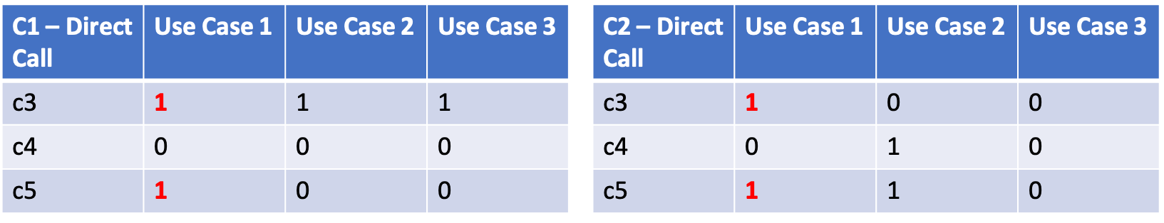
Step 3b: Compute Direct/Indirect Call Patterns
Direct Call Pattern (DCP)/Indirect Call Pattern (ICP): Whether two classes have similar pattern of interaction with other classes in terms of direct calls and indirect calls.
C1 and C2 may not have a direct call relation with each other however both have direct call relations with C3 and C5 respectively.
DCP_{c1,c2} = 2/9

Slide 13
Step 4: Perform Clustering
We use the well-known Hierarchical Clustering. The algorithm has the following steps
Needs target number of partitions “n”
Initially each class is assigned to a single partition Pi
Then partitions with the highest similarity scores are merged
Similarity Score _{c1, c2} = DCR _{c1, c2} + DCP _{c1, c2} + ICR _{c1, c2} + ICP _{c1, c2}
The step is iterated till “n” is achieved

Slide 14
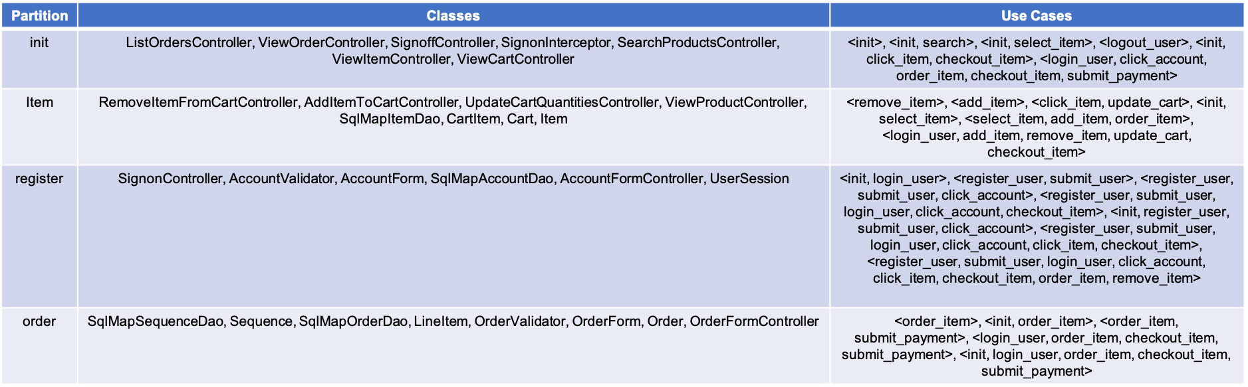
Step 5: Obtain Partitions
We obtained five partitions from Jpetstore using “n” = 5. The detail of the partitions are below.

Slide 15
Empirical Evaluation
We compared Mono2Micro against 4 baselines using five evaluation metrics.
We conducted a survey of Mono2Micro with industry practitioners to get their feedback
Based on the evaluation and the survey we answer the following research questions
RQ1: How does Mono2Micro perform based on the quality of partitioning using a set of metrics?
RQ2: How fast is Mono2Micro’s partitioning?
RQ3: How helpful do industry practitioners find Mono2Micro in refactoring their monolithic applications?

Slide 16
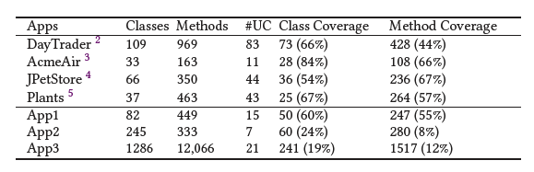
Subject Applications
We considered 4 open-source applications and 3 proprietary applications.
We chose the open-source applications based on whether they can be deployed and run, and have been used in prior evaluations
Open-source applications have higher class-coverage (66%-88%)
Proprietary applications are larger but have lower class-coverage (8%-55%)

Slide 17
Baseline Techniques
We compare Mono2Micro with 4 baselines
FoSCI: Creates functional atoms using a hierarchical clustering approach and merges the atoms using a genetic algorithm to generate final partitions
CoGCN: Partitions a monolith by minimizing the effect of outlier classes that might be present in the embeddings of other classes
Bunch: Considers the hill-climbing algorithm to generate partitions from an external module dependency graph (MDG)
MEM: Considers the minimum spanning tree (MST) approach to generate partitions. We consider their logical and semantic coupling strategies

Slide 18
Metrics
We consider 5 metrics for the evaluation
Structure Modularity (SM): measures modularity quality of partition in terms of the structural cohesiveness and coupling. The higher the better.
Inter Call Percentage (ICP) measures the percentage of runtime call occurring between two partitions. The lower the better.
Business Context Purity (BCP) measures the average entropy of business use cases per partition. The lower the better.
Interface Number (IFN) measures the number of interfaces in a microservice. The lower the better.
Non-Extreme Distribution (NED) measures how evenly the size of a microservice is. The lower the better.

Slide 19
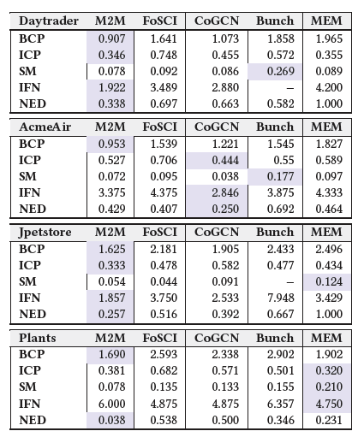
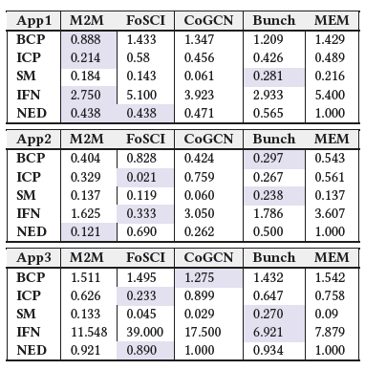
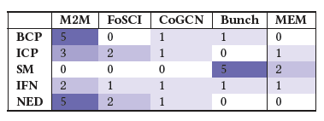
Results – RQ1
How does Mono2Micro perform based on the quality of partitioning using a set of metrics?
Overall Winners
Considering BCP and NED, Mono2Micro significantly outperformed others
Considering ICP and IFN Mono2Micro performed better than other approaches however the performance does not hold across the majority of applications
For SM, Bunch outperformed all other approaches although NED scores for Bunch are higher than others indicating non-extreme distribution.
Proprietary Applications
Open-source Applications

Slide 20
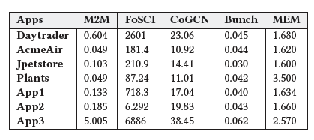
Results – RQ2
How fast is Mono2Micro’s partitioning?
Mono2Micro takes significantly less amount of time than FoSCI, CoGCN, and MEM
Bunch with the hill-climbing takes the least amount of time
FoSCI with the genetic algorithm takes the most amount of time

Slide 21
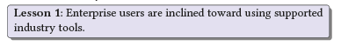
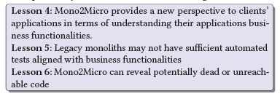
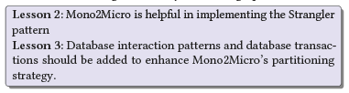
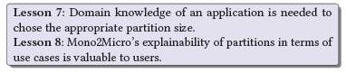
Results – RQ3
How helpful do industry practitioners find Mono2Micro in refactoring their monolithic applications?
20 Questions were adopted from existing surveys
21 participants returned the survey results (21% tech sales, 21% software architects, 16% software developers, 84% of participants have 10+ years of experience)

Slide 22
Conclusion and Future Work
Our approach captures and preserves the temporal relationships, it uses the relationships to group classes into disjoint partitions
Our experiment results show the efficacy of the approach when compared with baselines
In future, we plan to continue our investigation
Expand the quality metrics and provide further guidance to create efficient use cases
Conduct extensive verification and validation of approach by trying it against large enterprise real-life application
Based on the survey, we plan to add database interaction and transaction patterns to refine recommendations, automate test case generation, redefine NED constraints, generate partition size and so on.

Slide 23
THANKS

